Slide 1

Basic Data Analytics Techniques
data-action-lab.com

Slide 2
LEARNING OBJECTIVES
Understand the origin and function of business intelligence.
Understand and be able to apply a selection of fundamental data analysis concepts and techniques.
Exposure to a simple but comprehensive data analysis pipeline process from data collection to data presentation, in preparation for carrying out a similar process in the upcoming lab.

Slide 3
OUTLINE
Background and Process
Insight via Number Crunching: Some Core Concepts
Insight via Number Crunching: Some Core Techniques
Exercise

Slide 4
Introduction and Review

Slide 5

THE DATA ANALYSIS PIPELINE
Data modeling and conceptual analysis
Data collection
Data transformation
Data storage
Data exploration
Data presentation

Slide 6
THE DATA ANALYSIS PIPELINE
Data modeling and conceptual analysis
Data collection
Data transformation
Data storage
Data exploration
Data presentation
Today:
Putting it all together in the context of business intelligence and data analysis for business intelligence.

Slide 7
Background and Process

Slide 8
Business Intelligence – Business Analytics
Use data (and information) about internal operations and the state of the market to support informed decision making about business operations and business strategy.
No firmly agreed upon definition of these terms – is one a subset of the other?
Goals: increased situational awareness + improved foresight

Slide 9
History of Business Intelligence
Late 1800s: people started to recognize that they could use data to gain a competitive advantage
1950s: advent of the first business database for decision support
1980s -1990s: computers and data becoming increasingly available - data warehouses, data mining – still very technical and specialized
2000s: trying to take business analytics out of the hands of data miners and other specialists and more into the hands of domain experts
Now: big data and specialized techniques have arrived on the scene, but so has data visualization, dashboards, software as a service
1865
1950s
1980-90s
2000s
2019

Slide 10
Business Intelligence and Data Science
Historically, one of the streams contributing to modern day Data Science
System of interest: the commercial realm - the market in which you are involved
Sources of data: transaction data, financial data, sales data, organizational data
Goals: provide awareness of competitors, consumers and internal activity and use this to support decision making
Culture and preferred techniques: datamarts, key performance indicators, consumer behaviour, slicing and dicing, business 'facts’
The ultimate goal is still the same: insight into your system of interest.

Slide 11
Business Intelligence and the Data Pipeline
Our general data pipeline model also works for business intelligence.
What are some aspects of the business intelligence pipeline that might distinguish it from a more generic analysis pipeline?

Slide 12
Insight Via # Crunching: Core Concepts

Slide 13


Finding Patterns, Generalizations and Structure
Pattern: A predictable, repeating regularity
Structure: An organization of elements in a system
Generalization: Creation of more general or abstract concepts from more specific concepts or instances
Underlying goal during analysis - find patterns or structure in our data, draw conclusions via these patterns or structures.
Finding patterns and structure is not bad or wrong, per se, it's how you use these discoveries – the conclusions that you draw - that is important.
https://upload.wikimedia.org/wikipedia/commons/d/d0/TOAT_AFM.png

Slide 14
Independent vs Dependent Variables
In an experimental setting:
Control/Extraneous Variables: We do our best to keep these controlled and unchanging while other variables are changed
Independent: We control the values of the variable. We suspect that they influence the dependent variables.
Dependent: We don't control the values - they are generated in some way during the experiment, and presumably are dependent on everything
How do these translate over to other datasets?
Plant height
Hours sunlight

Slide 15
Types of Data
Numerical Data: integers or continuous numbers
1, 7, 34.654, 0.000004
Text Data: strings of text – may be restricted to a certain number of characters
“Welcome to the park”, “AAAAA”, “345”, “45.678”
Categorical Data: a fixed number of values, may be numeric or represented by strings. There is no specific or inherent ordering
(‘red’,’blue’,’green’),(‘1’,’2’,’3’)
Ordinal Data: Categorical data with an inherent ordering. Unlike integer data, the spacing between values is not defined
(very cold, cold, tepid, warm, super hot)

Slide 16
Turning categorical data into numerical (count) data
We can useful turn categorical data into numeric data by generating frequency counts of the different values of the categorical variable.
This in turn allows us to apply numerical analysis techniques.
House Colour | Frequency
red | 40
blue | 13
green | 2

Slide 17
The Special Role of Categorical Data
Categorical data play a special role:
In data science, we talk about a categorical variable with a pre-defined set of values
In experimental science, a factor is an independent variable with the levels of the variable defined - it may also be viewed as a category of treatment
In business analytics, people talk about dimensions (with members) vs measures
However we label these types of variables, we can use these them to subset our data, or roll up/summarize our data.

Slide 18
Hierarchical / Nested / Multilevel Data / MODELS
If a categorical variable has multiple levels of abstraction, we can create levels out of this variable.
We can view these levels as new categorical variables, in a sense.
The ‘new’ categorical variable has a pre-defined relationship with the more detailed level.
This is common with time and space variables – we can ‘zoom’ in or out.
This lets us talk about the granularity of the data – what is the ‘maximum zoom’?
Year | Quarter | Count
2012 | 1 | 34
2012 | 2 | 12
2012 | 3 | 52
2012 | 4 | 0
2013 | 1 | 21
2013 | 2 | 9
2013 | 3 | 112
2103 | 4 | 8

Slide 19
Insights VIA # Crunching: Core Techniques

Slide 20
Data Summarizing
Min: Smallest value of variable
Max: Largest value of variable
Median: Middle value of variable
Mode: Most frequent value
Unique Values: List of unique values
Signal | Type
4.31 | Blue
5.34 | Orange
3.79 | Blue
5.19 | Blue
4.93 | Green
5.76 | Orange
3.25 | Orange
7.12 | Orange
2.85 | Blue

Slide 21
Rolling Up Your Data
We can perform an operation over a set (or subset) of the data - typically over a column of the data.
When we do this, we can think of this as compressing or 'rolling up' the many data values into a single representative value.
Typical roll up functions are 'mean', 'sum' and 'count’.
If we apply the same roll up function to many different columns we can think of this as mapping (a list of) columns to functions.
Signal | Type
4.31 | Blue
5.34 | Orange
3.79 | Blue
5.19 | Blue
4.93 | Green
5.76 | Orange
3.25 | Orange
7.12 | Orange
2.85 | Blue

Slide 22
Contingency Tables / Pivot Tables
Contingency Table: A table used to examine the relationship between two categorical variables - specifically the frequency of one variable relative to a second variable (cross tabulation).
Pivot Table: A table generated in a software application by applying operations (e.g. sum, count, mean) to variables, possibly based on another (categorical) variable. Can be used to create a contingency table.
 | Large | Medium | Small
Blue | 1 | 32 | 31
Orange | 14 | 11 | 0
Green | 5 | 5 | 5

Slide 23
Analysis Through Visualization
Analysis broadly defined:
identifying patterns or structure
adding meaning to these patterns or structure by interpreting them in the context of your system.
Option 1: use analysis techniques to do this.
Option 2: visualize the data and use the analytic power of our (perceptual) brain to come to meaningful conclusions about these patterns.

Slide 24
Some simple visualizations to reveal patterns
Scatter plot: best suited for two numeric variables
Line chart: numeric variable and categorical variable
Bar chart: best suited for one categorical and one numeric - or multiple categorical/nested categorical data and

Slide 25
EXAMPLE (ARTIFICIAL)

Slide 26
LOADING THE DATA
Use your software/analysis tool’s functionality (you will need to learn its subtleties ) to load the data.
How can you confirm that the data has been loaded successfully?

Slide 27
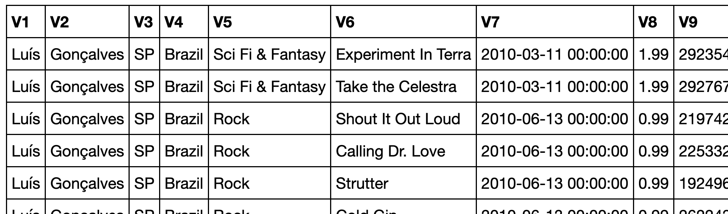
LOADING THE DATA

Slide 28
DATA PREPARATION
Prepare a back-up version of the original dataset.
Make back-ups regularly as you transform the original dataset.
Tips:
Label the data for ease of use.
Assigned the correct data types (strings, numbers, factors, dates, etc.) to features
Create new variables
Subset the data for ease of visualization/analysis

Slide 29
DATA PREPARATION
fname
lname
pv
country
genre
track
purchased data
cost
duration

Slide 30
NUMBER CRUNCHING AND ANALYSIS
Generate 1-way/n-way contingency tables on the whole dataset or on subsets
Use variations to get more information
Create new data frames from contingency tables (using counts and other functions)

Slide 31
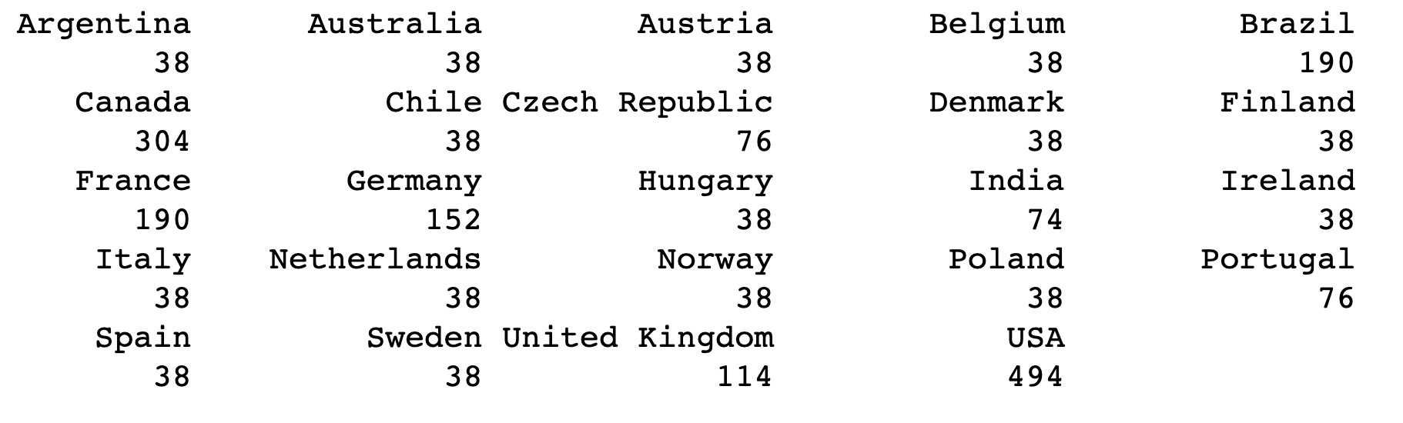
NUMBER CRUNCHING AND ANALYSIS

Slide 32
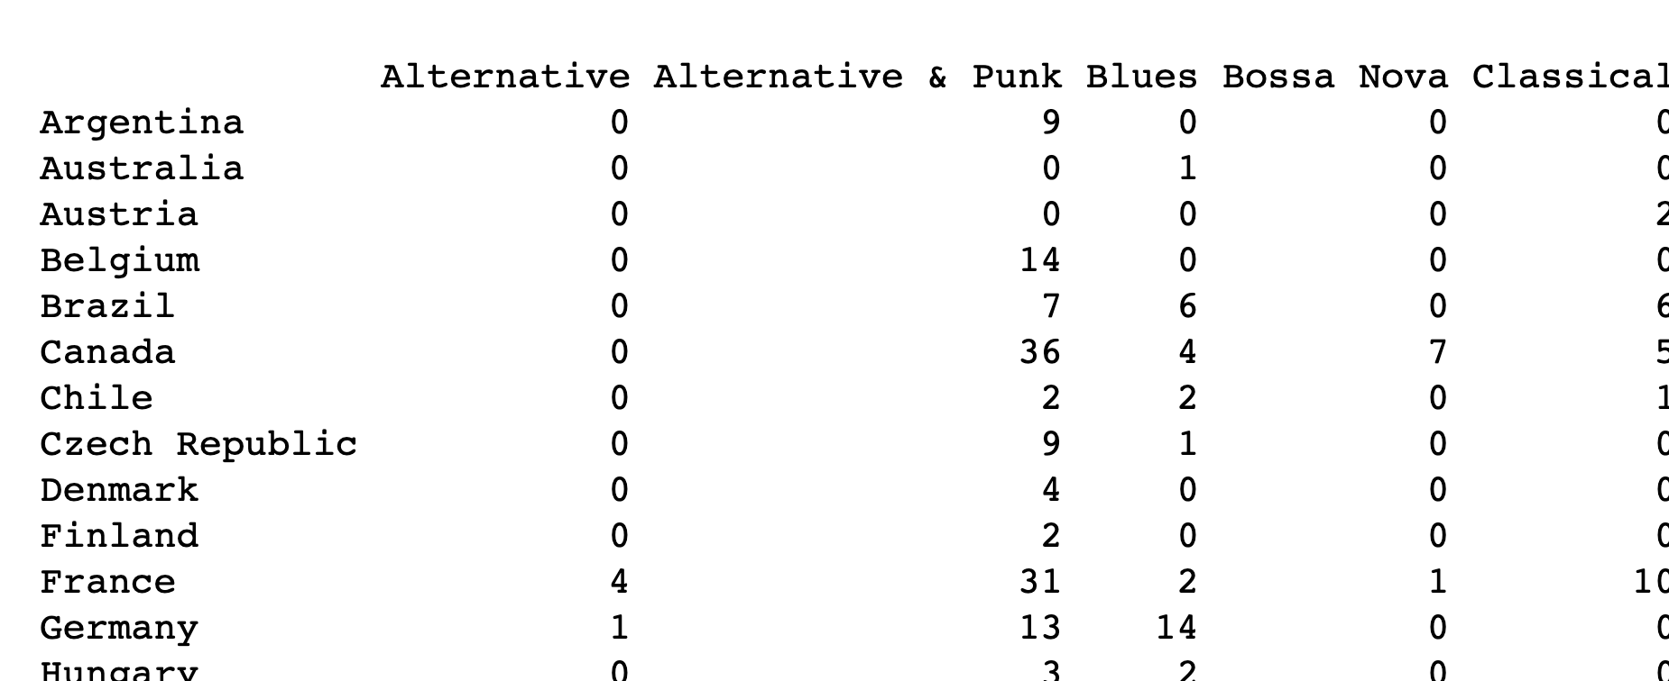
NUMBER CRUNCHING AND ANALYSIS

Slide 33
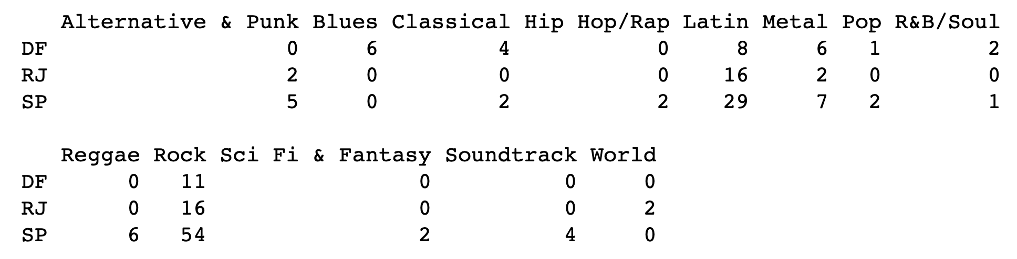
NUMBER CRUNCHING AND ANALYSIS
2-way province/genre contingency table for Brazil

Slide 34
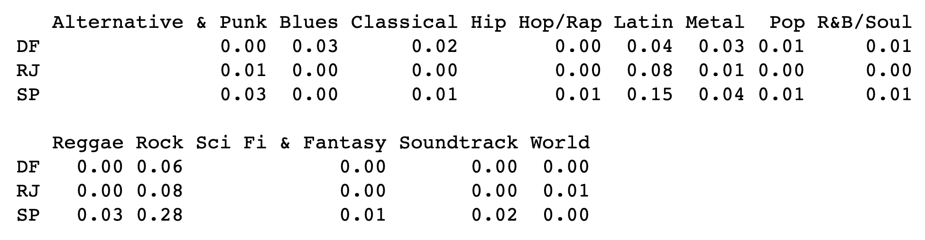
NUMBER CRUNCHING AND ANALYSIS
2-way province/genre proportion contingency table for Brazil

Slide 35
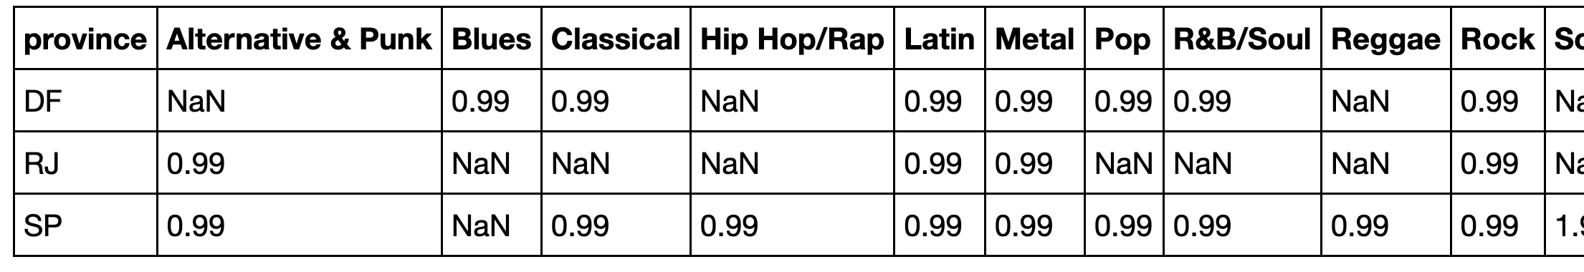
NUMBER CRUNCHING AND ANALYSIS
2-way province/genre purchase cost information for Brazil

Slide 36
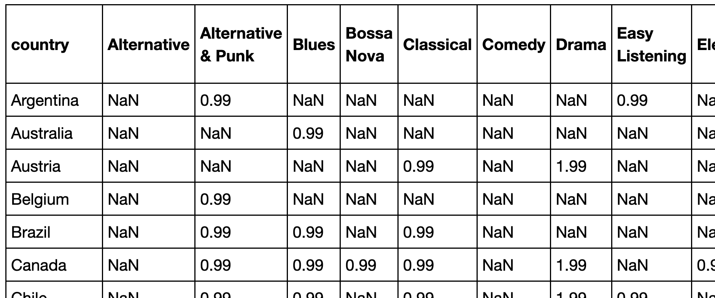
NUMBER CRUNCHING AND ANALYSIS
2-way province/genre purchase (mean) cost information for countries

Slide 37
DATA VISUALIZATION
Generate 1D and multivariate charts to analyze/understand the data
Use variations in style/format
Use multiple visualizations for the same variables to find optimal methods
barcharts
scatterplots
line graphs
Etc.

Slide 38
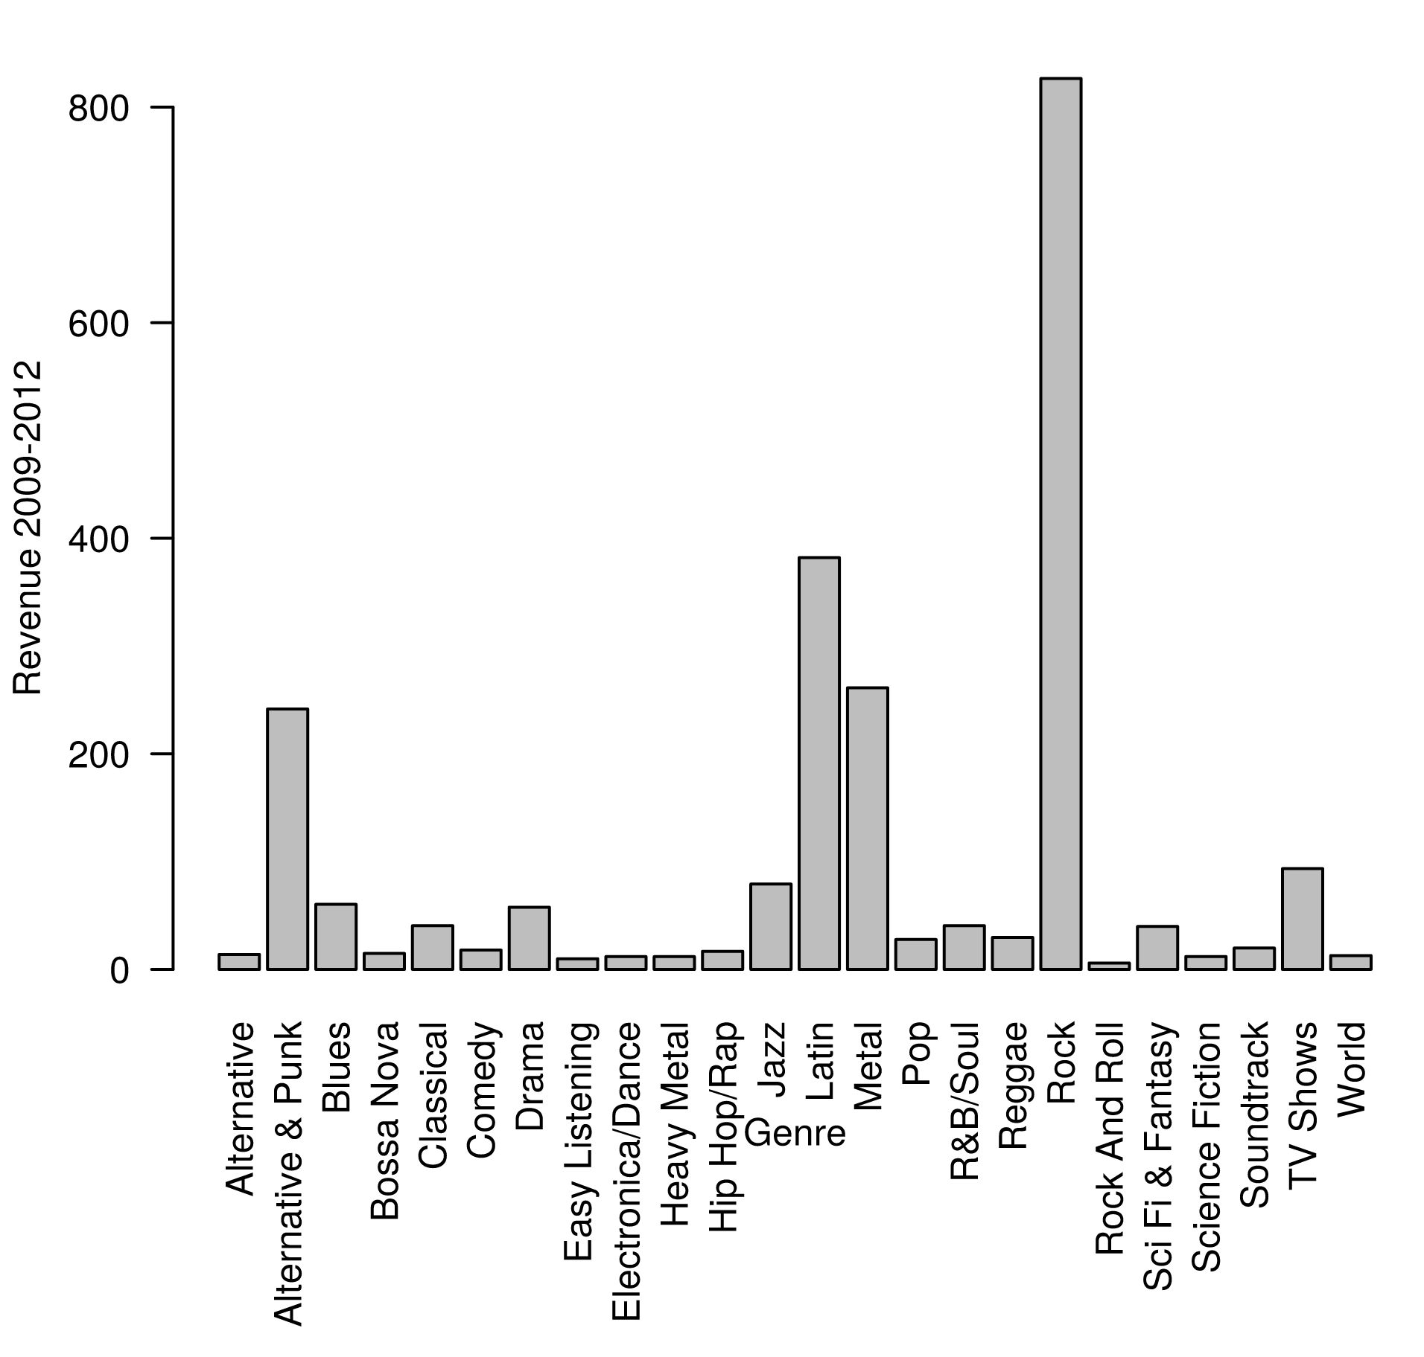
NUMBER CRUNCHING AND ANALYSIS

Slide 39
EXERCISE

Slide 40
Data and System Identification
Identify a system of interest OR identify a dataset that exists and the system that it represents.

Slide 41
Data Relevance (I)
Determine what data you have about the system of interest OR what data you could have, if you were to collect it.

Slide 42
Conceptual Model
Develop a conceptual model of the system.

Slide 43
Goals of Analysis
Determine:
what questions do you want to answer
what issue do you want to address
what decision do you want to make
what relationships do you want to explore

Slide 44
Data Relevance (II)
Determine: if you have the data you need to answer these questions, explore these relationships, etc.
If not determine how to get that data OR go back and come up with a question you can answer using your data, a relationship you can explore using your data, etc.

Slide 45
Data Storage
Determine how to store your data.

Slide 46
Date Export
Determine how to export, transform and/or load your data so that it's available for analysis.

Slide 47
Data Validation
Determine the quality of your data - what it is representing and how well it is representing that which it is representing.

Slide 48
Data Exploration
Explore your data and discover patterns, relationships, structures.

Slide 49
Data Presentation
Present your findings.

